Slide 1
Classification
Naïve Bayes Classifier
Ensemble Classifiers

Slide 2
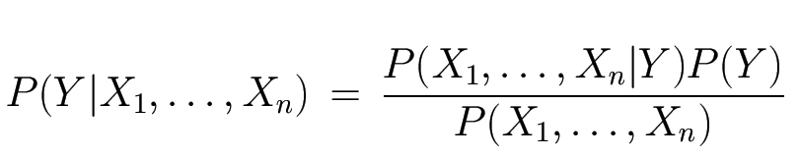
The Bayes Classifier
Use Bayes Rule!
Why did this help? Well, we think that we might be able to specify how features are “generated” by the class label
Likelihood
Prior
Normalization Constant

Slide 3
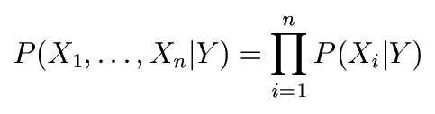
The Naïve Bayes Model
The Naïve Bayes Assumption: Assume that all features are independent given the class label Y
Equationally speaking:

Slide 4
Naïve Bayesian Classification
Also called Simple Bayesian Classification
Why Naïve/Simple??
Class Conditional Independence
Effect of an attribute values on a given class is independent of the values of other attributes
This assumption simplifies computations

Slide 5
Bayesian Classifiers
Approach:
compute the posterior probability P(C | A₁, A₂, …, A_{n}) for all values of C using the Bayes theorem
Choose value of C that maximizes P(C | A₁, A₂, …, A_{n})
Equivalent to choosing value of C that maximizes P(A₁, A₂, …, A_{n}|C) P(C)
How to estimate P(A₁, A₂, …, A_{n} | C )?

Slide 6
Naïve Bayes Classifier
Assume independence among attributes A_{i} when class is given:
P(A₁, A₂, …, A_{n} |C) = P(A₁| C_{j}) P(A₂| C_{j})… P(A_{n}| C_{j})
Can estimate P(A_{i}| C_{j}) for all A_{i} and C_{j}.
New point is classified to C_{j} if P(C_{j}) Π P(A_{i}| C_{j}) is maximal.

Slide 7
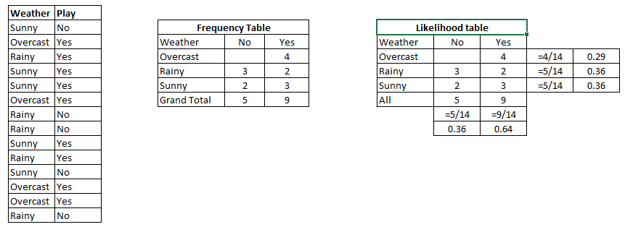
Example

Slide 8
How to Estimate Probabilities from Data?
Class: P(C) = N_{c}/N
e.g., P(No) = 7/10, P(Yes) = 3/10
For discrete attributes: P(A_{i} | C_{k}) = |A_{ik}|/ N_{c}
where |A_{ik}| is number of instances having attribute A_{i} and belongs to class C_{k}
Examples:
P(Status=Married|No) = 4/7 P(Refund=Yes|Yes)=0
k

Slide 9
How to Estimate Probabilities from Data?
For continuous attributes:
Discretize the range into bins
Two-way split: (A < v) or (A > v)
choose only one of the two splits as new attribute
Probability density estimation:
Assume attribute follows a normal distribution
Use data to estimate parameters of distribution (e.g., mean and standard deviation)
Once probability distribution is known, can use it to estimate the conditional probability P(A_{i}|c)

Slide 10
How to Estimate Probabilities from Data?
Normal distribution:
One for each (A_{i},c_{i}) pair
For (Income, class=No):
If Class=No
sample mean = 110
sample variance = 2975

Slide 11
Example of Naïve Bayes Classifier
Given a Test Record:
P(X|Class=No) = P(Refund=No|Class=No) × P(Married| Class=No) × P(Income=120K| Class=No) = 4/7 × 4/7 × 0.0072 = 0.0024
P(X|Class=Yes) = P(Refund=No| Class=Yes) × P(Married| Class=Yes) × P(Incm=120K| Class=Yes) = 1 × 0 × 1.2 × 10⁻⁹ = 0
Since P(X|No)P(No) > P(X|Yes)P(Yes)
Therefore P(No|X) > P(Yes|X) => Class = No

Slide 12
Naïve Bayes Classifier
If one of the conditional probability is zero, then the entire expression becomes zero
Probability estimation:
c: number of classes
p: prior probability
m: parameter

Slide 13
Example of Naïve Bayes Classifier
A: attributes
M: mammals
N: non-mammals
P(A|M)P(M) > P(A|N)P(N)
=> Mammals

Slide 14
Naïve Bayesian Classification
Example
Age
Income
Student
Credit_rating
Class:Buys_comp
<=30
HIGH
N
FAIR
N
<=30
HIGH
N
EXCELLENT
N
31…..40
HIGH
N
FAIR
Y
>40
MEDIUM
N
FAIR
Y
>40
LOW
Y
FAIR
Y
>40
LOW
Y
EXCELLENT
N
31…..40
LOW
Y
EXCELLENT
Y
<=30
MEDIUM
N
FAIR
N
<=30
LOW
Y
FAIR
Y
>40
MEDIUM
Y
FAIR
Y
<=30
MEDIUM
Y
EXCELLENT
Y
31….40
MEDIUM
N
EXCELLENT
Y
31….40
HIGH
Y
FAIR
Y
>40
MEDIUM
N
EXCELLENT
N

Slide 15
Naïve Bayesian Classification
Example
A= (<=30,MEDIUM, Y,FAIR, ???)
We need to max.
P(A|C_{j})P(C_{j}) for j =1,2.
P(C_{j}) is computed from training sample
P(buys_comp=Y) = 9/14 = 0.643
P(buys_comp=N) = 5/14 = 0.357
How to calculate P(X|C_{i})P(C_{i}) for i=1,2?
P(A|C_{j}) P(A₁, A₂, A₃, A₄|C) = ΠP(A_{k}|C)

Slide 16
Naïve Bayesian Classification
Example
P(age<=30 | buys_comp=Y)=2/9=0.222
P(age<=30 | buys_comp=N)=3/5=0.600
P(income=medium | buys_comp=Y)=4/9=0.444
P(income=medium | buys_comp=N)=2/5=0.400
P(student=Y | buys_comp=Y)=6/9=0.667
P(student=Y | buys_comp=N)=1/5=0.200
P(credit_rating=FAIR | buys_comp=Y)=6/9=0.667
P(credit_rating=FAIR | buys_comp=N)=2/5=0.400

Slide 17
Naïve Bayesian Classification
Example
P(X | buys_comp=Y)=0.222*0.444*0.667*0.667=0.044
P(X | buys_comp=N)=0.600*0.400*0.200*0.400=0.019
P(X | buys_comp=Y)P(buys_comp=Y) = 0.044*0.643=0.028
P(X | buys_comp=N)P(buys_comp=N) = 0.019*0.357=0.007
CONCLUSION: A buys computer

Slide 18
Problem to Solve
Estimate the conditional probabilities for P(Red|Yes), P(SUV|Yes), P(Domestic|Yes) ,P(Red|No) , P(SUV|No), and P(Domestic|No)using the m-estimate approach, with p=1/2 and m=3
Predict the class label for a test sample (Red Domestic SUV) using Naïve Bayes approach.

Slide 19
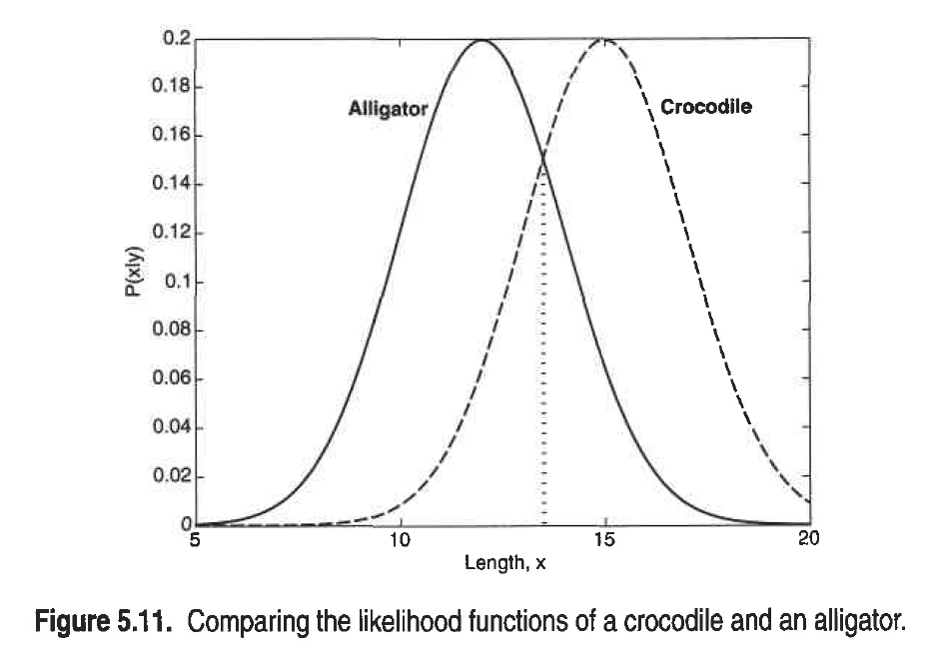
Probability of Error - Bayes Error Rate

Slide 20
Probability of Error

Slide 21
Naïve Bayes (Summary)
Robust to isolated noise points
Handle missing values by ignoring the instance during probability estimate calculations
Robust to irrelevant attributes
Independence assumption may not hold for some attributes
Use other techniques such as Bayesian Belief Networks (BBN)

Slide 22
Ensemble Classifiers

Slide 23
Ensemble Classifiers
Introduction & Motivation
Methods to create Ensemble
Bais Variance Decomposition
Construction of Ensemble Classifiers
Bagging
Boosting (Ada Boost)
Random Forests

Slide 24
Introduction & Motivation
Suppose that you are a patient with a set of symptoms
Instead of taking opinion of just one doctor (classifier), you decide to take opinion of a few doctors!
Is this a good idea? Indeed it is.
Consult many doctors and then based on their diagnosis; you can get a fairly accurate idea of the diagnosis.
Majority voting - ‘bagging’
More weightage to the opinion of some ‘good’ (accurate) doctors - ‘boosting’
In bagging, you give equal weightage to all classifiers, whereas in boosting you give weightage according to the accuracy of the classifier.

Slide 25
Ensemble Methods
Construct a set of classifiers from the training data
Predict class label of previously unseen records by aggregating predictions made by multiple classifiers

Slide 26
General Idea
Figure taken from Tan et. al. book “Introduction to Data Mining”

Slide 27
Rationale for Ensemble Methods
Statistical reasons
–A set of classifiers with similar training performances may have different generalization performances.
–Combining outputs of several classifiers reduces the risk of selecting a poorly performing classifier.
Large volumes of data
–If the amount of data to be analyzed is too large, a single classifier may not be able to handle it; train different classifiers on different partitions of data.
Too little data
–Ensemble systems can also be used when there is too little data; resampling techniques.

Slide 28
Rationale for Ensemble Methods

Slide 29
Why does it work?
Suppose there are 25 base classifiers
Each classifier has error rate, ε = 0.35
Assume classifiers are independent
Probability that the ensemble classifier makes a wrong prediction:
CHK out yourself if it is correct!!
Example taken from Tan et. al. book “Introduction to Data Mining”

Slide 31
Ensemble Classifiers (EC)
An ensemble classifier constructs a set of ‘base classifiers’ from the training data
Methods for constructing an EC
Manipulating training set
Manipulating input features
Manipulating class labels
Manipulating learning algorithms

Slide 32
Ensemble Classifiers (EC)
Manipulating training set
Multiple training sets are created by resampling the data according to some sampling distribution
Sampling distribution determines how likely it is that an example will be selected for training – may vary from one trial to another
Classifier is built from each training set using a particular learning algorithm
Examples: Bagging & Boosting

Slide 33
Ensemble Classifiers (EC)
Manipulating input features
Subset of input features chosen to form each training set
Subset can be chosen randomly or based on inputs given by Domain Experts
Good for data that has redundant features
Random Forest is an example which uses DT as its base classifiers

Slide 34
Ensemble Classifiers (EC)
Manipulating class labels
When no. of classes is sufficiently large
Training data is transformed into a binary class problem by randomly partitioning the class labels into 2 disjoint subsets, A0 & A1
Re-labelled examples are used to train a base classifier
By repeating the class labeling and model building steps several times, and ensemble of base classifiers is obtained
How a new tuple is classified?
Example – error correcting output coding (pp 307)

Slide 35
Ensemble Classifiers (EC)
Manipulating learning algorithm
Learning algorithms can be manipulated in such a way that applying the algorithm several times on the same training data may result in different models
Example – ANN can produce different models by changing network topology or the initial weights of links between neurons
Example – ensemble of DTs can be constructed by introducing randomness into the tree growing procedure – instead of choosing the best split attribute at each node, we randomly choose one of the top k attributes

Slide 36
Ensemble Classifiers (EC)
First 3 approaches are generic – can be applied to any classifier
Fourth approach depends on the type of classifier used
Base classifiers can be generated sequentially or in parallel

Slide 37
Typical Ensemble Procedure

Slide 38
Ensemble Classifiers
Ensemble methods work better with ‘unstable classifiers’
Classifiers that are sensitive to minor perturbations in the training set
Examples:
Decision trees
Rule-based
Artificial neural networks

Slide 39
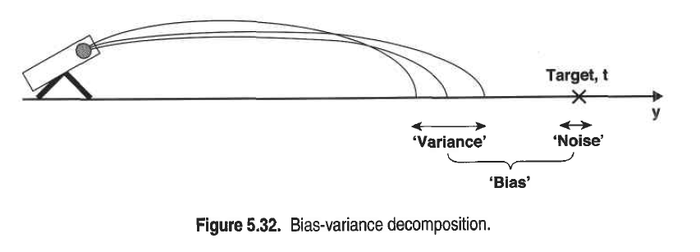
Bias-Variance Decomposition

Slide 40
Bias Vs Variance

Slide 41
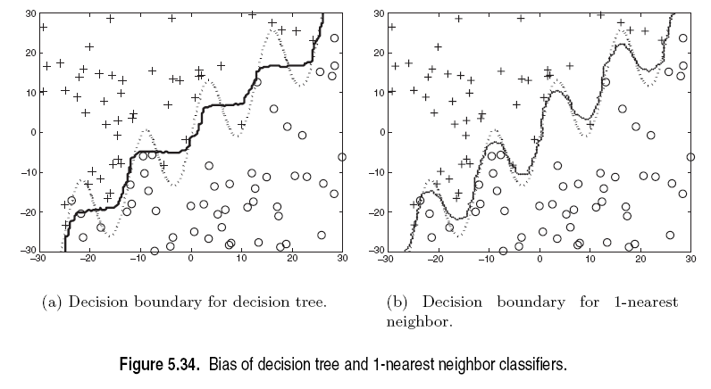
Bias: Example

Slide 42
Examples of Ensemble Methods
How to generate an ensemble of classifiers?
Bagging
Boosting
Random Forests

Slide 43
Bagging
Also known as bootstrap aggregation
Sampling uniformly with replacement
Build classifier on each bootstrap sample
0.632 bootstrap
Each bootstrap sample D_{i} contains approx. 63.2% of the original training data
Remaining (36.8%) are used as test set
Example taken from Tan et. al. book “Introduction to Data Mining”

Slide 45
Bagging: Boostrap Aggregation
Analogy: Diagnosis based on multiple doctors’ majority vote
Training
Given a set D of d tuples, at each iteration i, a training set D_{i} of d tuples is sampled with replacement from D (i.e., boostrap)
A classifier model M_{i} is learned for each training set D_{i}
Classification: classify an unknown sample X
Each classifier M_{i} returns its class prediction
The bagged classifier M* counts the votes and assigns the class with the most votes to X
Prediction: can be applied to the prediction of continuous values by taking the average value of each prediction for a given test tuple
Accuracy
Often significant better than a single classifier derived from D
For noise data: not considerably worse, more robust
Proved improved accuracy in prediction

Slide 46
Bagging
Accuracy of bagging:
Works well for small data sets
Example:
X | 0.1 | 0.2 | 0.3 | 0.4 | 0.5 | 0.6 | 0.7 | 0.8 | 0.9 | 1.0
y | 1 | 1 | 1 | -1 | -1 | -1 | -1 | 1 | 1 | 1
Actual Class labels
Example taken from Tan et. al. book “Introduction to Data Mining”

Slide 47
Bagging
Decision Stump
Single level decision binary tree
Entropy – x<=0.35 or x<=0.75
Accuracy at most 70%
Actual Class labels

Slide 48
Bagging
Accuracy of ensemble classifier: 100% ☺
Example taken from Tan et. al. book “Introduction to Data Mining”

Slide 49
Bagging- Final Points
Works well if the base classifiers are unstable
Increased accuracy because it reduces the variance of the individual classifier
Does not focus on any particular instance of the training data
Therefore, less susceptible to model over-fitting when applied to noisy data
What if we want to focus on a particular instances of training data?

Slide 50
Boosting
An iterative procedure to adaptively change distribution of training data by focusing more on previously misclassified records
Initially, all N records are assigned equal weights
Unlike bagging, weights may change at the end of a boosting round

Slide 51
Boosting
Records that are wrongly classified will have their weights increased
Records that are classified correctly will have their weights decreased
Example 4 is hard to classify
Its weight is increased, therefore it is more likely to be chosen again in subsequent rounds
Example taken from Tan et. al. book “Introduction to Data Mining”

Slide 52
Boosting
Equal weights are assigned to each training tuple (1/d for round 1)
After a classifier M_{i} is learned, the weights are adjusted to allow the subsequent classifier M_{i+1} to “pay more attention” to tuples that were misclassified by M_{i}.
Final boosted classifier M* combines the votes of each individual classifier
Weight of each classifier’s vote is a function of its accuracy
Adaboost – popular boosting algorithm

